Slide 1

PUBG
FINISH PLACEMENT PREDICTION
SAIDAKBAR PARDAEV | NAVNEET CHAUHAN | ANTONY PAULSON | ASHISH SOLANKI

Slide 2
INTRODUCTION
The Project is based on Kaggle Competition (Start date: October 4th, 2018)
PUBG-finish-placement-prediction which started on 4th October 2018 and ends on 30th January 2019.
The aim is to predict “winPlacePerc” which is a percentile winning placement, where 1 corresponds to 1st place, and 0 corresponds to last place in the match.
In total there are 29 attributes and more than 4.45 mn datasets.
Each row corresponds to a single player and his performance across the 29 parameters like headshot kills, kills, heals, vehicle destroyed, walk distance, weapons acquired etc.

Slide 3
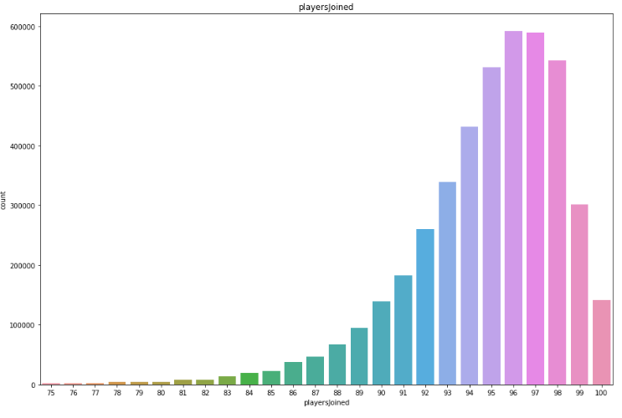
EXPLORATORY DATA ANALYSIS
Checked for missing values and only 1 record was found and removed.
Average number of players who joined matches was analysed.
It would have a significant impact on various other significant parameters like Kills, damageDealt, maxPlace, and matchDuration.
These parameters were normalized.

Slide 4
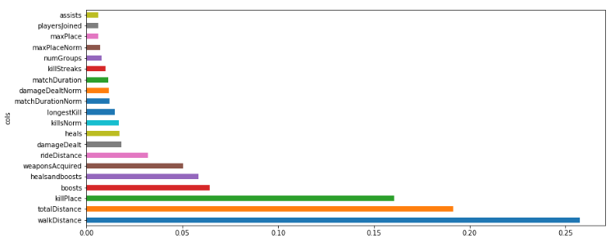
EXPLORATORY DATA ANALYSIS
The next step was to identify which features had significant importance in predicting win place %

Slide 5
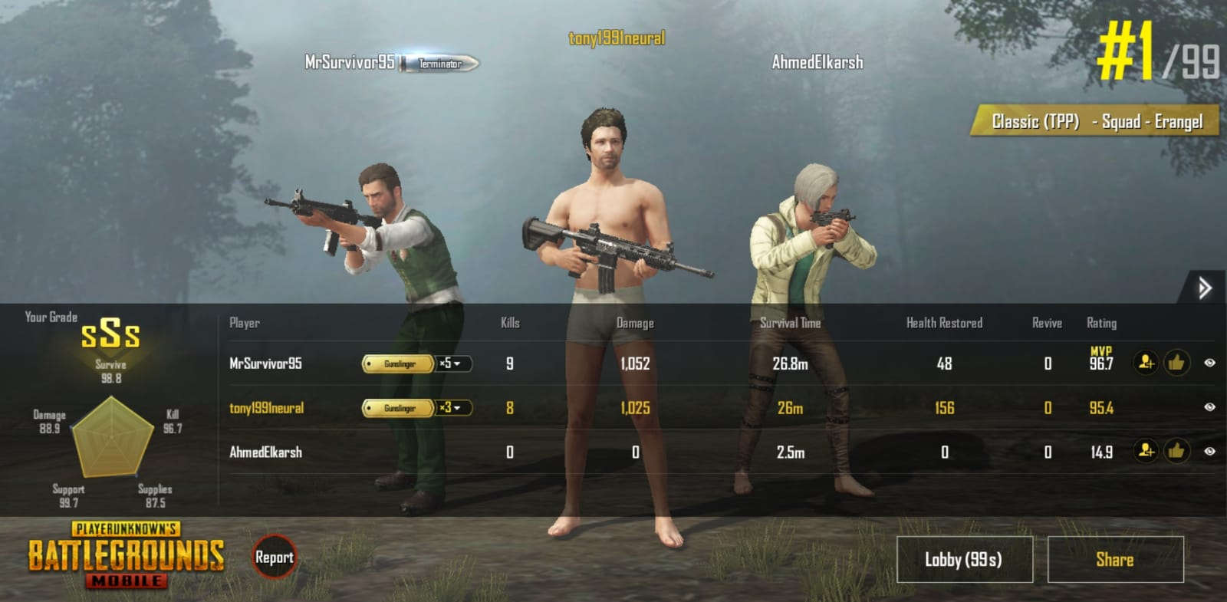
FINAL SNAPSHOT AFTER WINNING

Slide 6
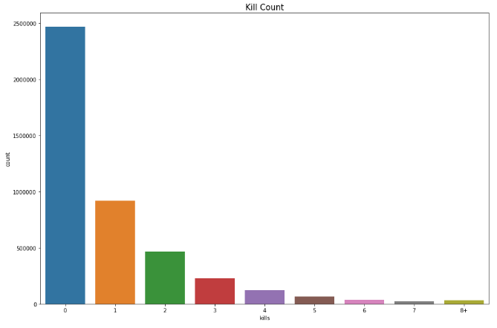
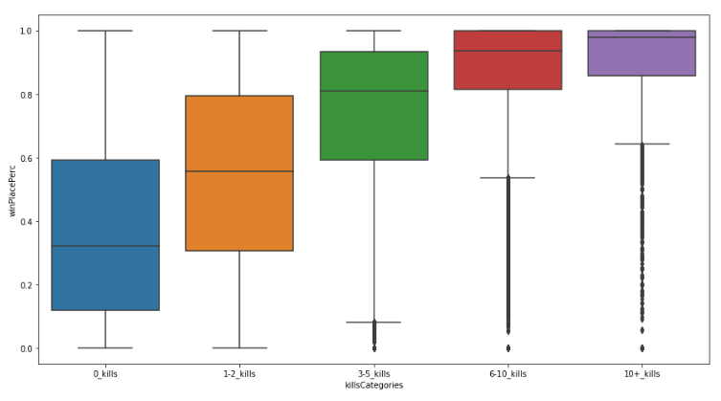
EXPLORATORY DATA ANALYSIS
The Kills were analyzed as it is also an important feature.
The analysis showed that around 2500000 players died without killing anyone
The players who killed more than 10 players were more likely to achieve a winPlace% near to 1.

Slide 7
FEATURE ENGINEERING
Following new features were added based on the learnings above to improve accuracy.
'headshotrate' = 'kills’ / 'headshotKills'
'killStreakrate' = 'killStreaks’ / 'kills'
'healthitems' = 'heals’ + 'boosts'
'totalDistance' = 'rideDistance' + 'walkDistance’ + 'swimDistance'
'killPlace_over_maxPlace' = 'killPlace' / 'maxPlace'
'headshotKills_over_kills' = 'headshotKills' / 'kills'
'distance_over_weapons' = 'totalDistance' / 'weaponsAcquired']
'walkDistance_over_heals' = 'walkDistance' / 'heals']
'walkDistance_over_kills' = 'walkDistance' / 'kills']
'killsPerWalkDistance' = 'kills' / 'walkDistance'
'skill' = 'headshotKills' + 'roadKills'

Slide 8
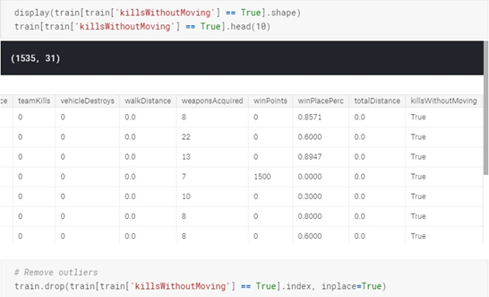
EXPLORATORY DATA ANALYSIS
To find out outliers – CHEATERS were identified.
All those players who have significant number of kills without moving a single inch were identified and removed.
Further anomalies regarding unbelievable number in walk distance, ride distance, swim distance, weapons acquired were removed.

Slide 9
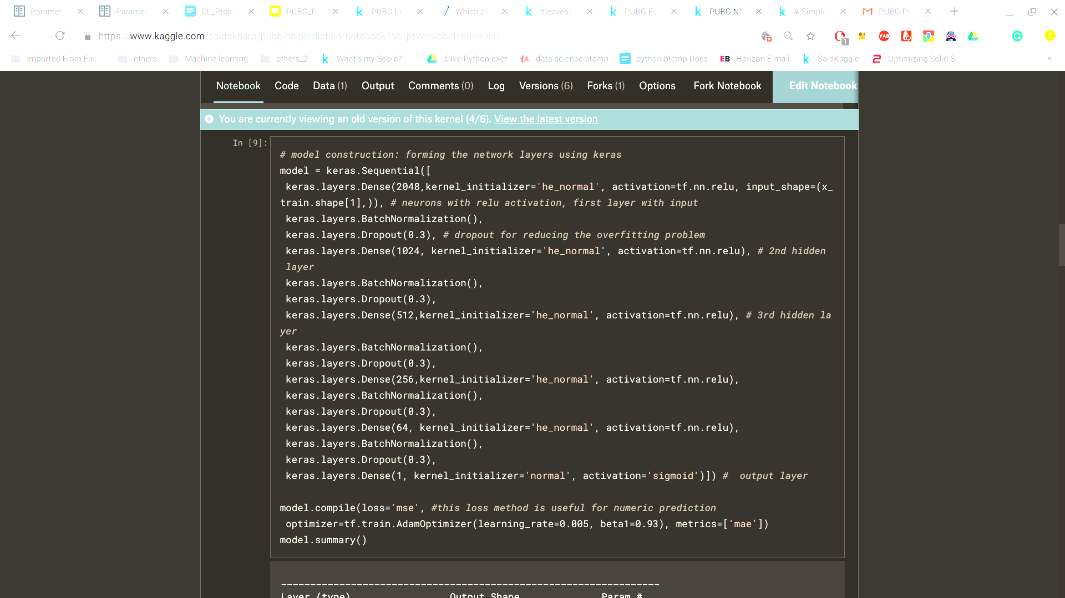
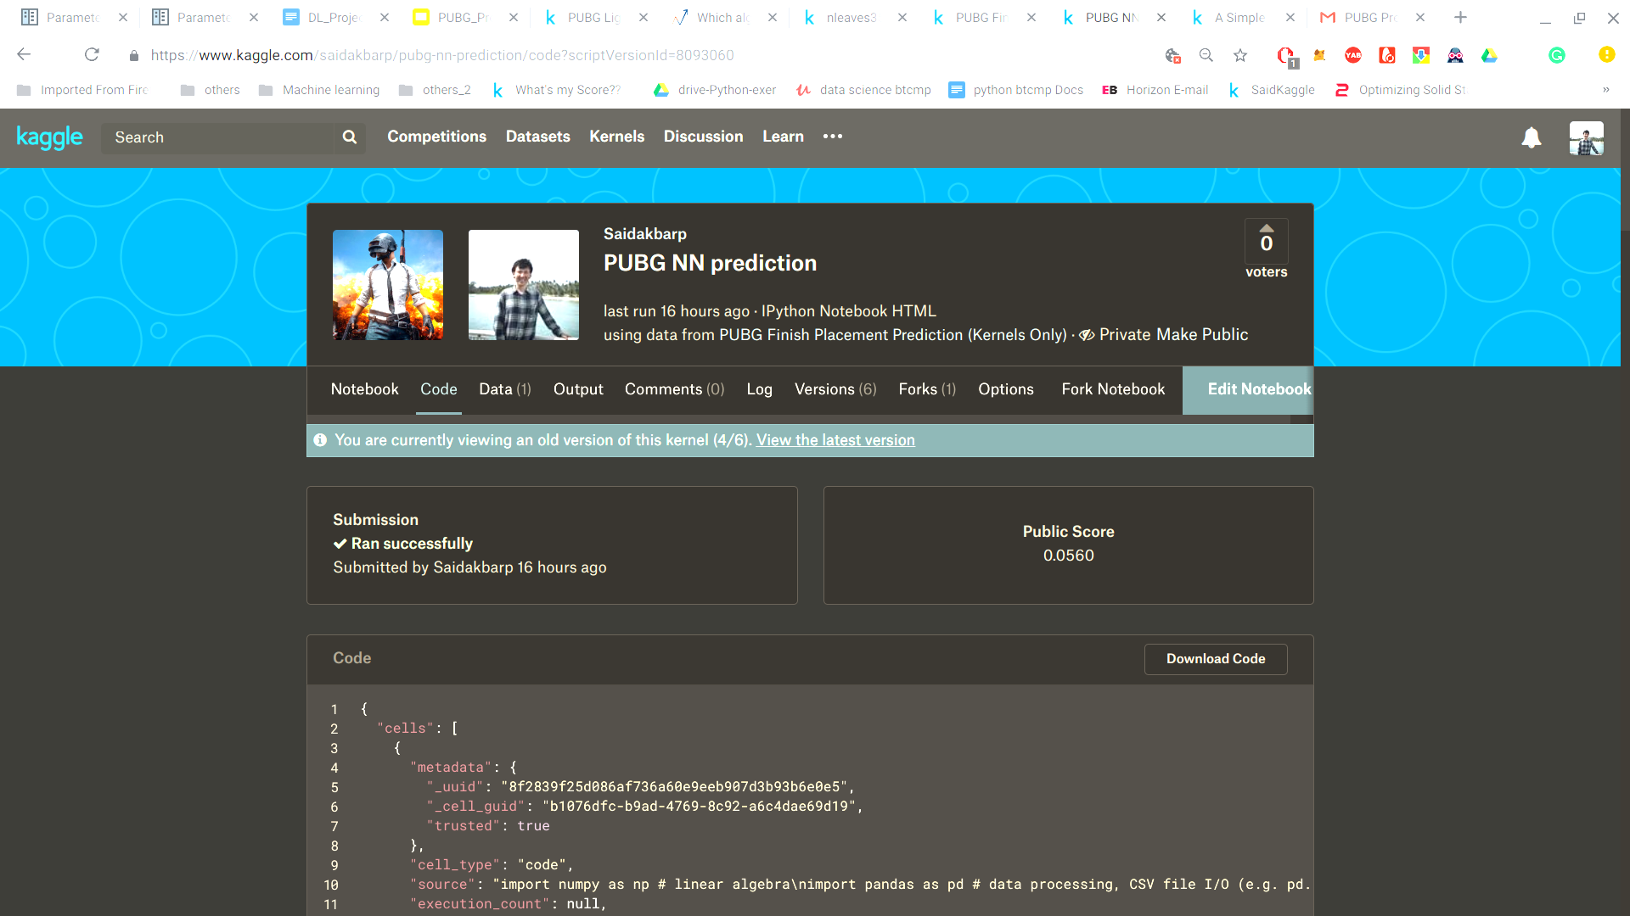
MODELS: KERAS NN LIMITATIONS
Leaderboard position: 442
Requires more resources
Computationally expensive
GridSearchCV for parameter tuning with entire dataset takes more time

Slide 10
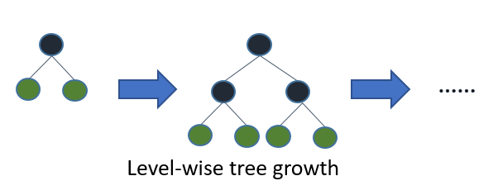
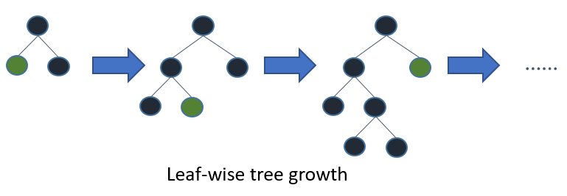
MODEL CHOICE: LIGHT GBM
Gradient boosting machine
Light GBM developed by Microsoft in late 2016
similar to boosted trees
uses leaf wise growth
converts features into bins
fast and low memory usage
parallel learning is supported
Score is 0.036 before optimization and some feature editing
XG boost uses level wise tree growth
light GBM uses leaf wise tree growth

Slide 11
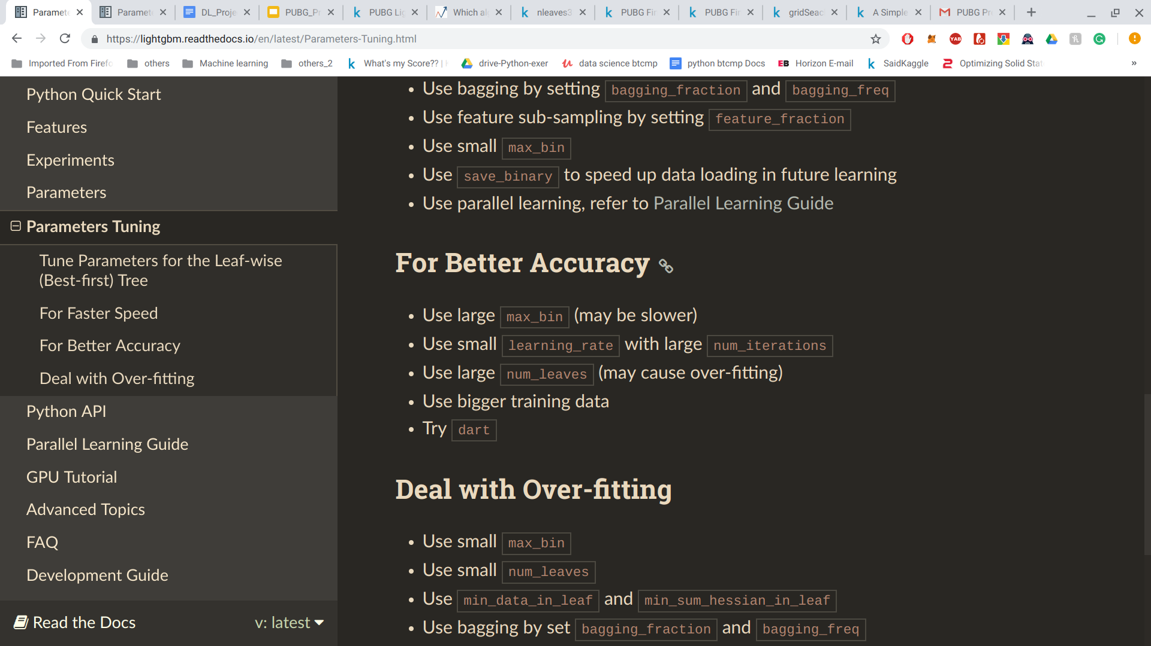
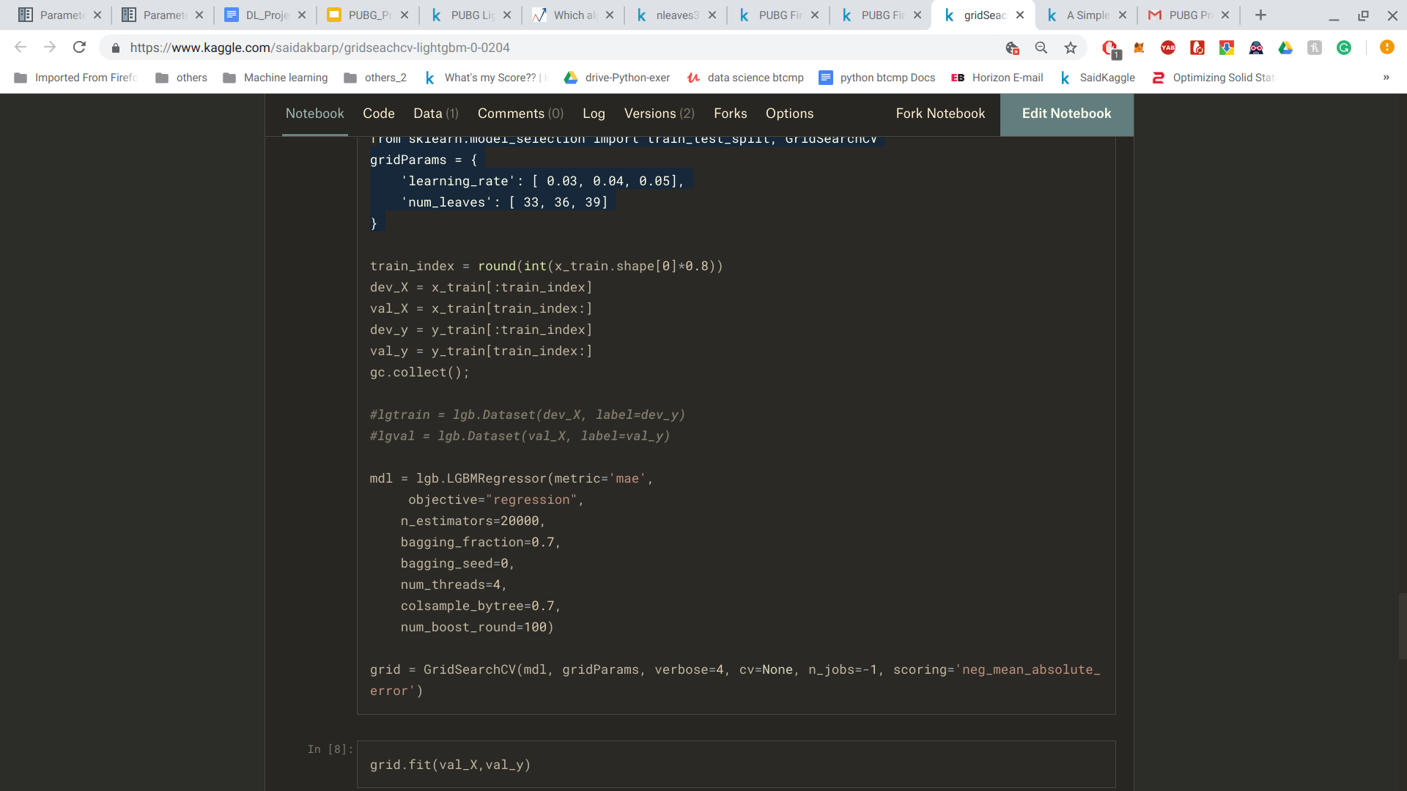
MODEL OPTIMIZATION
What parameters are important?
Documentation:
GridSearchCV:
Exhaustive search over the parameters specified
From sklearn.model_selection import GridSearchCV
gridParams = {
'learning_rate': [ 0.03, 0.04, 0.05],
'num_leaves': [ 33, 36, 39] }

Slide 12
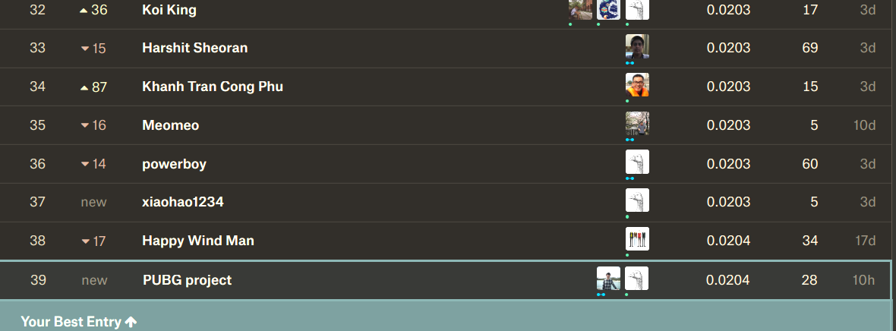
FINAL RESULT TOP 5% - 39TH OUT OF 1488 COMPETITORS
https://www.kaggle.com/c/pubg-finish-placement-prediction/leaderboard

Slide 13
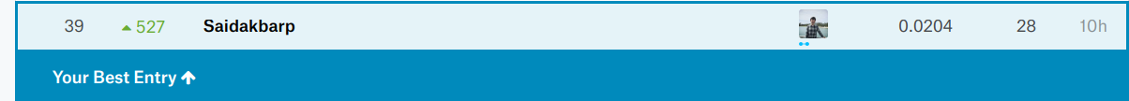
KEY OUTCOMES
Do not normalize dataset for gradient boosting machines (0.06 -> 0.0204)
Add relevant features - without feature engineering, result is 0.07 (600th place)
Parameter tuning is very important - If possible, use the entire dataset for cross-validation during gridSearch. One parameter change learning rate from 0.04 to 0.03 led to a jump of 60 positions up (100th -> 39th)
FUTURE IMPROVEMENTS
Use AWS Cloud Jupyter Notebook with at least 32GB RAM and NVidia K80
Use Keras NN
Use GridSearchCV with 5 fold cross-validation on the entire dataset to search in a wider range of parameter.
Possible outcomes: top 10
Improvements:
527 positions up

Slide 14
THANK YOU

